Slide 1
L3_Non-Linear Data Structures
Dr. Jay Dave
CSIS Dept, Hyderabad Campus

Slide 2
Data Structures and Algorithms Design (Merged-SEZG519/SSZG519)
L3_Non-Linear Data Structures

Slide 3
Content of L-3
3.1. Trees
3.1.1. Terms and Definition
3.1.2. Tree ADT
3.1.3. Applications
3.2. Binary Trees
3.2.1. Properties
3.2.2. Representations (Vector Based and Linked)
3.2.3. Binary Tree traversal (In Order, Pre Order, Post Order)
3.2.4. Applications
3.3. Heaps
3.3.1. Definition and Properties
3.3.2. Representations (Vector Based and Linked)
3.3.3. Insertion and deletion of elements
3.3.4. Heap implementation of priority queue
3.3.5. Heap sort

Slide 4
So far we studied
Linear data structure: A type of data structure where elements are arranged in a sequential order, and each element has a unique predecessor and successor (except for the first and last elements).
E.g.: Array, Linked List, Stack, Queue

Slide 5
Non-linear data structure
A non-linear data structure is a type of data structure in which elements are not organized sequentially but can be connected in various ways.
E.g. Tree, Graph

Slide 6
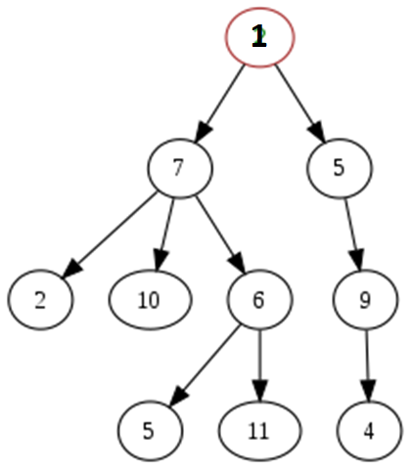
Tree

Slide 7
Basic terminologies
Node: Each element in the tree is a node. Each node can have child nodes connected to it.
Parent and child: A node that is directly connected to another node is considered the parent of that node. Conversely, the connected node is the child of the parent node.
E.g. 7 is parent node, 2,10,6 are its child nodes.
Leaf node: A node with no children is called a leaf node.
E.g. 2,10,5,11,4 are its leaf nodes.
Root: A node which has no parent is called a root node.
E.g. 1 is the root node.

Slide 8
Basic terminologies
Level: Level is the rank of the hierarchy and root node is termed as in level 0. If a node is at level x, then its parent is at level x-1 and its child nodes are at level x+1.
E.g. Node 10 is at level 2.
Height: Maximum number of nodes that is possible in a path from root node to a leaf node is the height of a tree.
E.g. Height of tree in example = 4
Degree: Maximum number of child nodes possible for a node is called degree.
E.g. Degree is 3 in example.
Sibling: The nodes which have the same parent are called siblings.
E.g. 2, 10, and 6 are siblings.

Slide 9
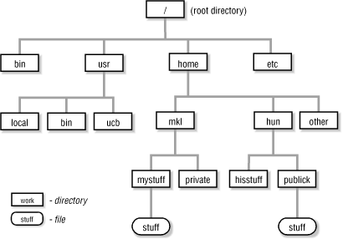
Applications of tree data structure
Representation of File systems

Slide 10
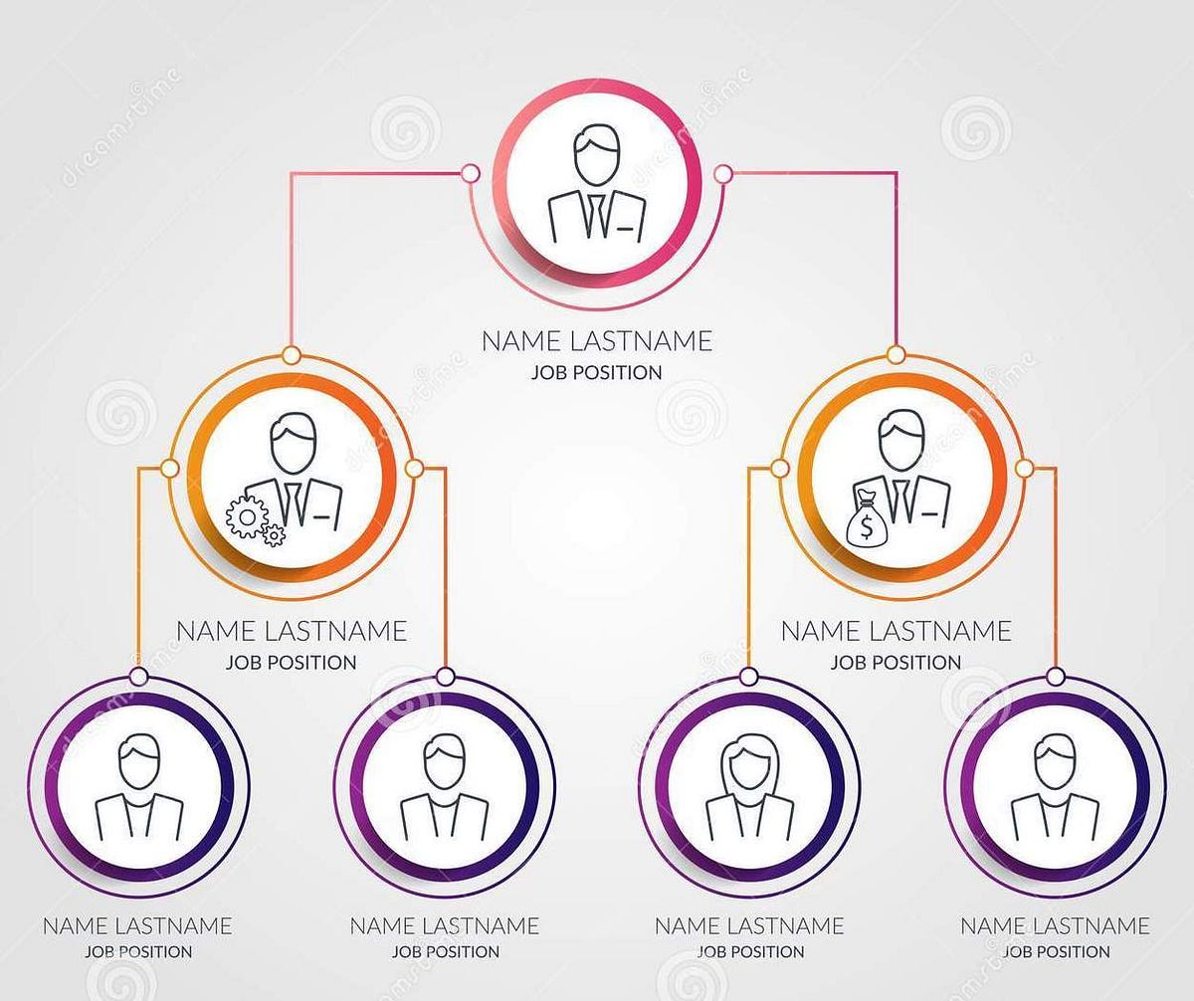
Applications of tree data structure
Representation organizational hierarchies

Slide 11
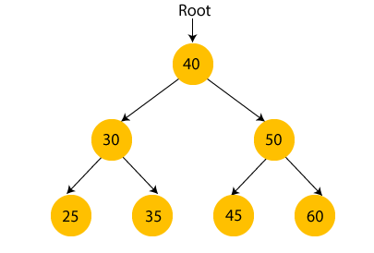
Applications of tree data structure
Binary Search Tree for efficient search

Slide 12
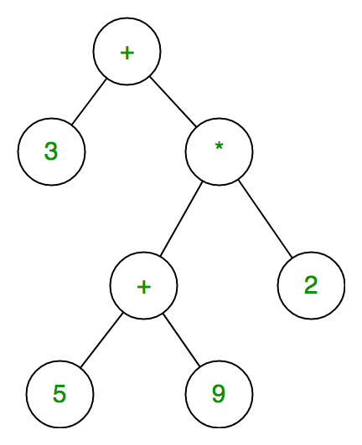
Applications of tree data structure
Tree for parsing and evaluation of expression

Slide 13
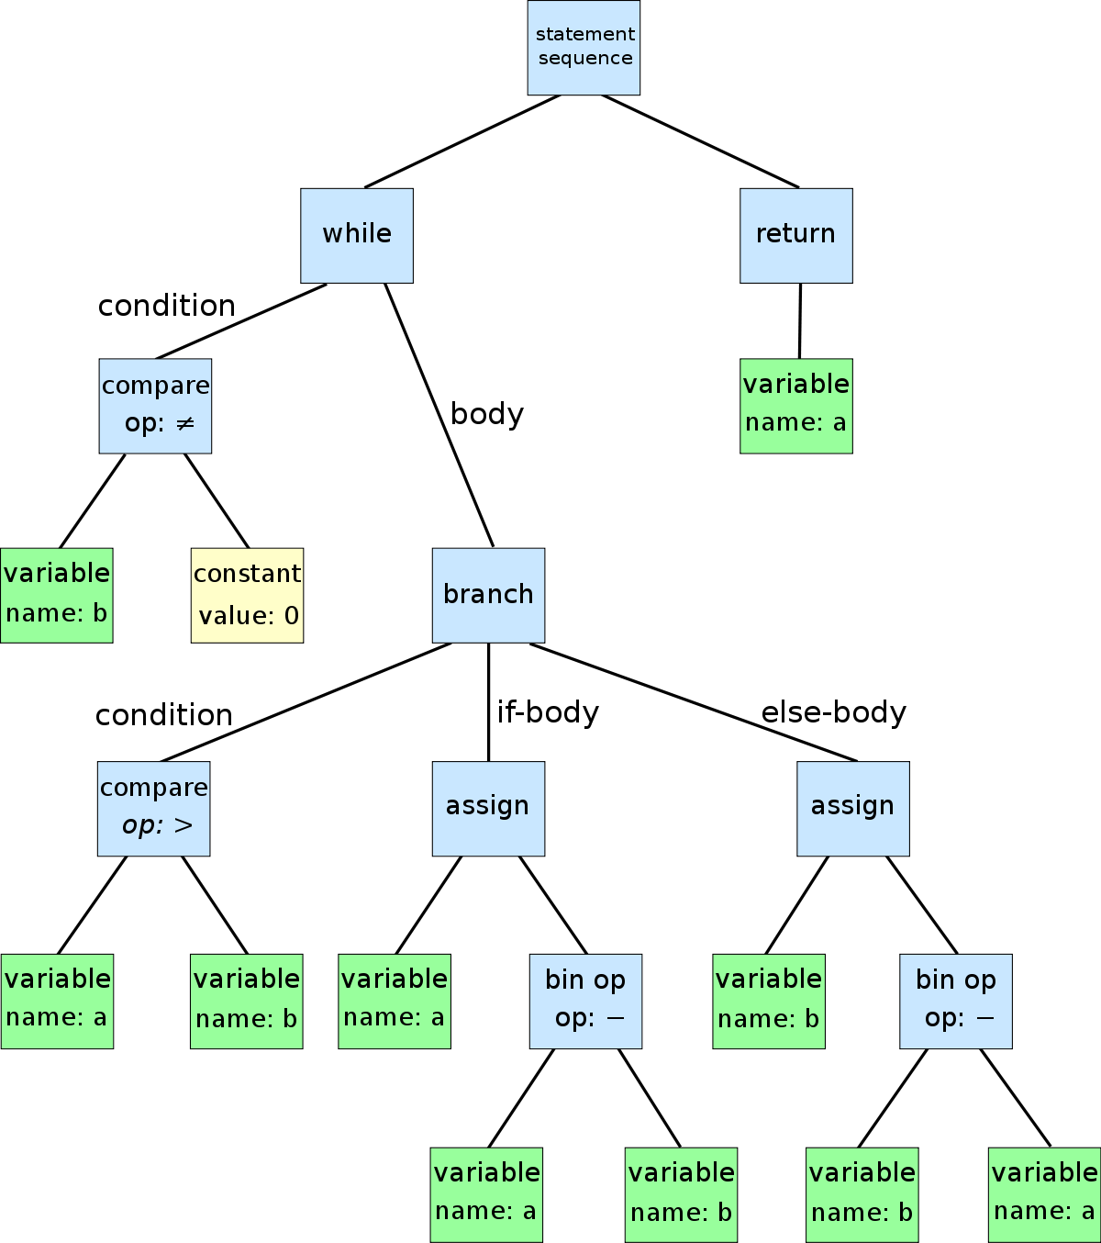
Applications of tree data structure
Representation the structure of source code

Slide 14
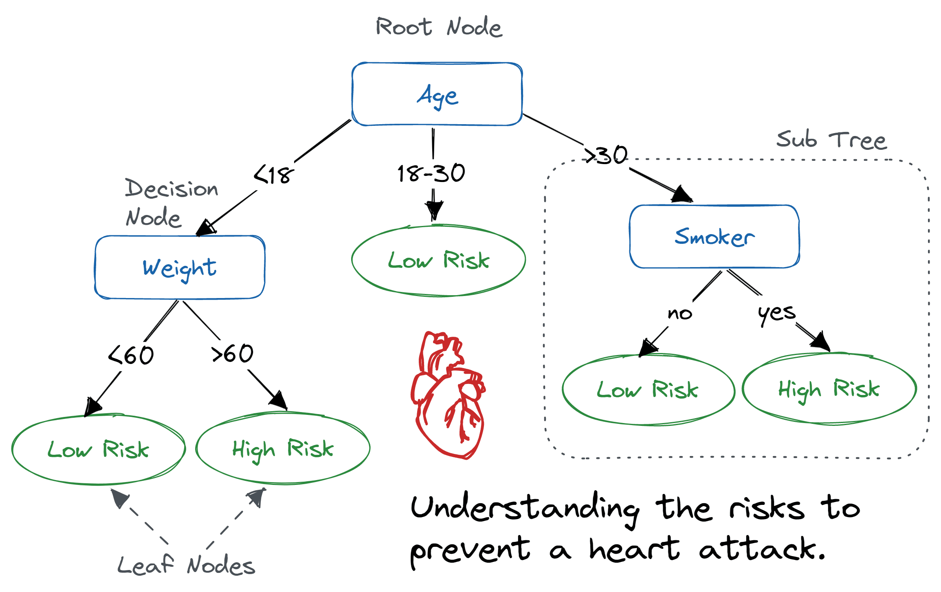
Applications of tree data structure
Decision tree

Slide 15
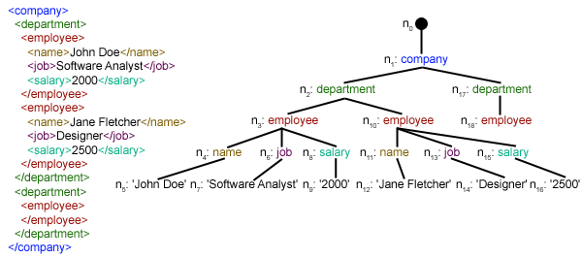
Applications of tree data structure
XML Parsing Tree

Slide 16
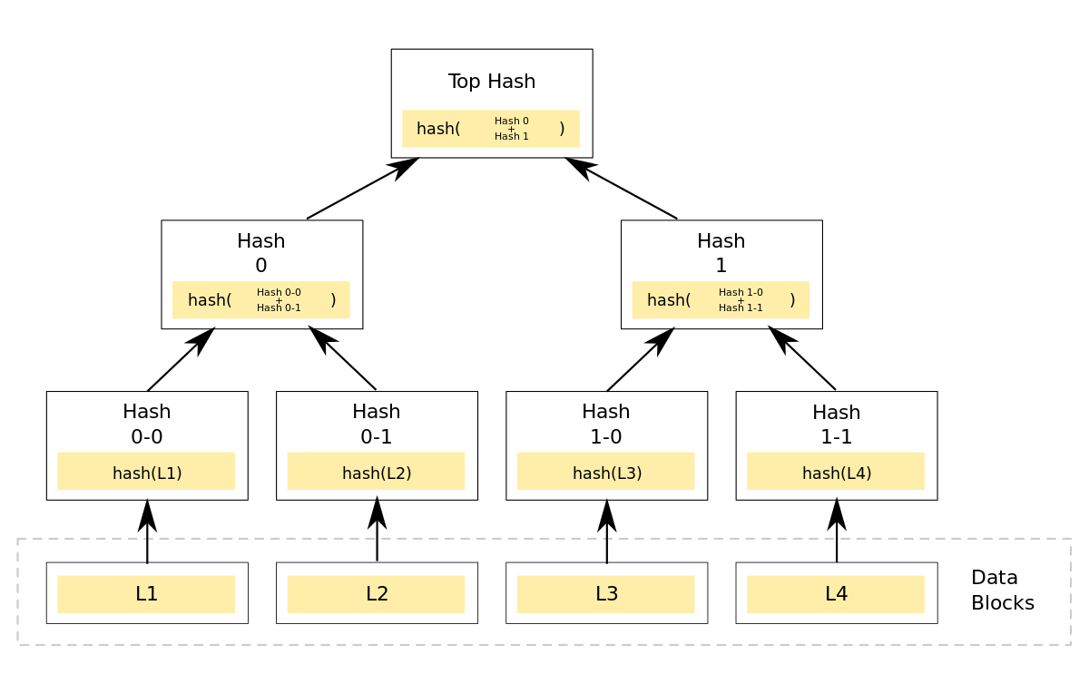
Applications of tree data structure
Merkle tree in Blockchain

Slide 17
Types of Tree
Binary Tree
Binary Search Tree
Heap tree
AVL Tree
B-Tree
Red-black Tree

Slide 18
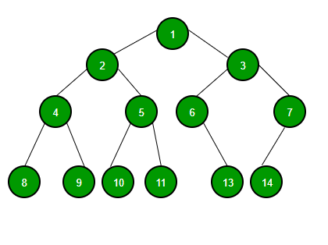
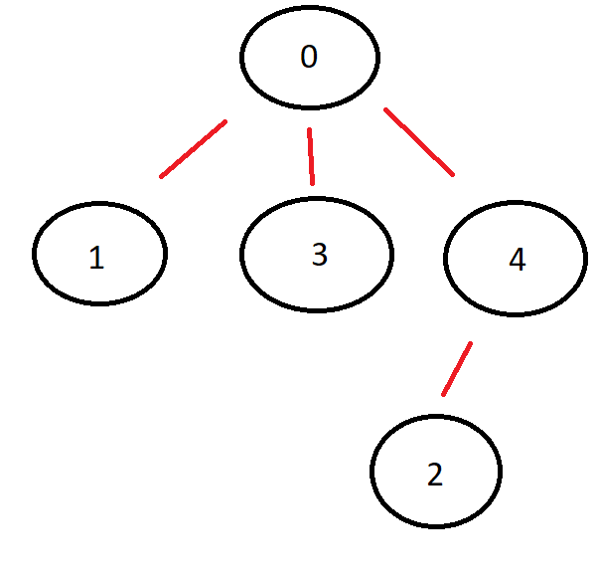
Binary Tree
A binary tree is a tree structure in which each node has at most two children.

Slide 19
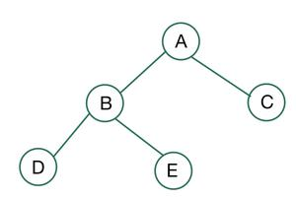
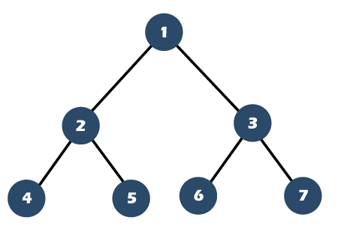
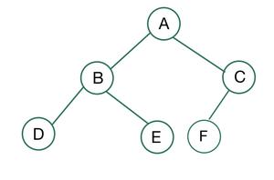
Full Binary Tree
A full binary tree is a binary tree in which every node has either zero or two children.

Slide 20
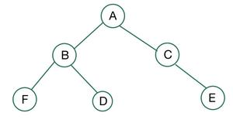
Complete Binary Tree
A complete binary tree is a binary tree in which all levels except last level have maximum number of possible nodes. Moreover, nodes in last level are appear as far left as possible.

Slide 21
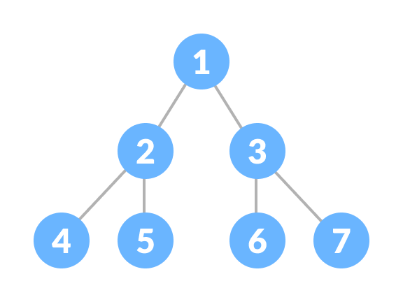
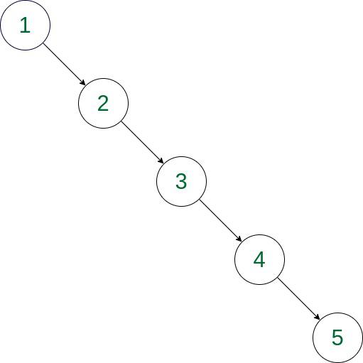
Properties of a binary tree
Max no. of nodes at x^{th} level = 2^{x}
Max no. of nodes in a binary tree of height h = 2^{h} – 1
Min no. of possible nodes in binary tree of height h = h
Max no. of leaf nodes in a binary tree of height h = 2^{h-1}
No. of edges in a binary tree with n number nodes = n – 1
No. of leaf nodes in a binary tree with n no. of internal node (degree = 2) = n + 1

Slide 22
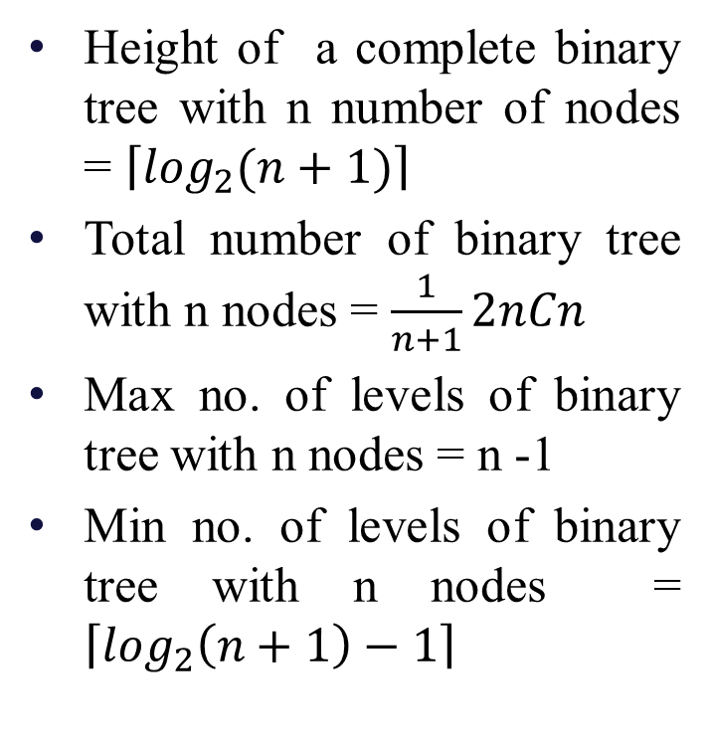
Properties of a binary tree
Height of a complete binary tree with n number of nodes = $\left\lceil \log_{2}(n+1)\right\rceil$
Total number of binary tree with n nodes = $\frac{1}{n+1}2nCn$
Max no. of levels of binary tree with n nodes = n -1
Min no. of levels of binary tree with n nodes = $\left\lceil \log_{2}\left(n+1\right)−1\right\rceil$

Slide 23
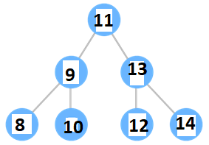
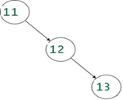
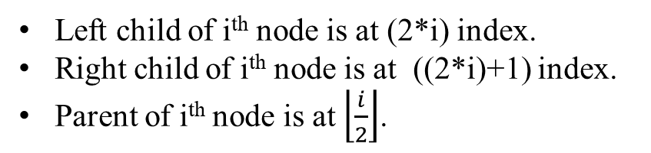
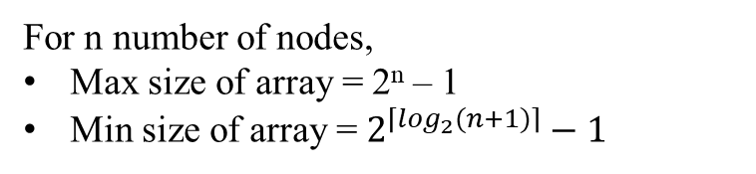
Array representation of Binary Tree
Left child of i^{th} node is at (2*i) index.
Right child of i^{th} node is at ((2*i)+1) index.
Parent of i^{th} node is at $\left\lfloor \frac{i}{2}\right\rfloor$.
1 | 2 | 3 | 4 | 5 | 6 | 7
11 | 9 | 13 | 8 | 10 | 12 | 14
1 | 2 | 3 | 4 | 5 | 6 | 7
11 | NULL | 12 | NULL | NULL | NULL | 13
For n number of nodes,
Max size of array = 2^{n} – 1
Min size of array = $2^{\left\lceil \log_{2}(n+1)\right\rceil }−1$

Slide 24
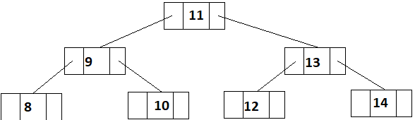
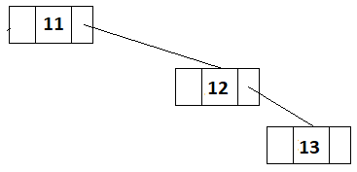
Linked List representation of Binary Tree
lc | data | rc
lc = link to left child
rc = link to right child

Slide 25
Array vs Linked List Representation
Array Representation
Any node can be accessed by calculating index
No storage needed for pointers
Empty entries may be there
Static representation
Linked List Representation
Traversal required
Storage needed for pointers
No Empty entries
Dynamic representation

Slide 26
Basic operations
Insertion
Deletion
Traversal
Merge

Slide 27
Insertion (Array representation)
SEARCH(rootind, key): Returns index of Key in tree
i ← rootind
if A[i] = key then
Return i
else
if 2*i < SIZE(A) then
SEARCH(2*i, key)
else if (2*i)+1 < SIZE(A) then
SEARCH((2*i)+1, key)
else
Return 0

Slide 28
Insertion (Array representation)
Insert(key, object): Insert Object as left/right child of Key
ind ← SEARCH (1, key)
if ind = 0 then
print “Search unsuccessful”
Exit
else
if A[2*ind] = NULL then
A[2*ind] ← object
else if A[(2*ind) + 1] = NULL then
A[(2*ind) + 1] ← object
else
print “Object cannot be inserted at desired location”
Exit

Slide 29
Deletion (Array representation)
Delete(key): Delete key object from tree if it is leaf
ind ← SEARCH (1, key)
if ind = 0 then
print “Search unsuccessful”
Exit
if A[2*ind] = NULL and A[(2*ind)+1] = NULL then
A[ind] = NULL
else
print “Key is not at leaf node”
Exit

Slide 30
Homework
Write algorithms for Search, Insert, Delete for linked list representation of a binary tree.

Slide 31
Traversal (Linked List representation)
Preorder:
Visit root node R
Traverse left subtree of R
Traverse right subtree of R
Inorder:
Traverse left subtree of R
Visit root node R
Traverse right subtree of R
Postorder:
Traverse left subtree of R
Traverse right subtree of R
Visit root node R

Slide 32
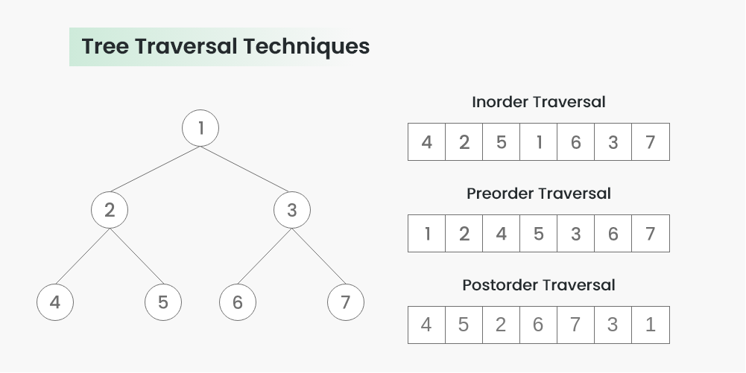
Traversal (Linked List representation)

Slide 33
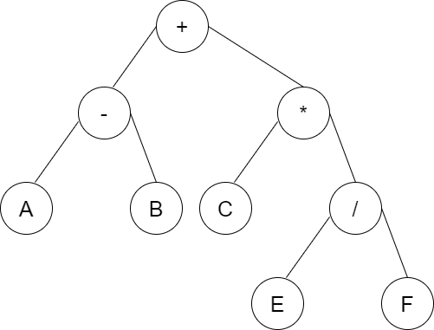
Traversal (Linked List representation)
Preorder:
+-AB*C/EF
Inorder:
A-B+C*E/F
Postorder:
AB-CEF/*+

Slide 34
Traversal (Linked List representation)
(A-B)+(C*(E/F))
Prefix:
+-AB*C/EF
Postfix:
AB-CEF/*+

Slide 35
Traversal (Linked List representation)
inorder(root)
ptr ← root
if ptr ≠ NULL then
inorder(ptr.left)
print(ptr.data)
inorder(ptr.right)
preorder(root)
ptr ← root
if ptr ≠ NULL then
print(ptr.data)
preorder(ptr.left)
preorder(ptr.right)
postorder(root)
ptr ← root
if ptr ≠ NULL then
postorder(ptr.left)
postorder(ptr.right)
print(ptr.data)

Slide 36
Traversal (Linked List representation)
preorder(root)
ptr ← root
if ptr ≠ NULL then
print(ptr.data)
preorder(ptr.left)
preorder(ptr.right)
11
9
8
10
13
12
14

Slide 37
Traversal (Linked List representation)
inorder(root)
ptr ← root
if ptr ≠ NULL then
inorder(ptr.left)
print(ptr.data)
inorder(ptr.right)
8
9
10
11
12
13
14

Slide 38
Traversal (Linked List representation)
postorder(root)
ptr ← root
if ptr ≠ NULL then
postorder(ptr.left)
postorder(ptr.right)
print(ptr.data)
8
10
9
12
14
13
11

Slide 39
Traversal (Linked List representation) Non-recursive
inorder(root)
ptr ← root
while TOP( ) ≠ NULL
or ptr ≠ NULL do
if ptr ≠ NULL then
PUSH(ptr)
ptr ← ptr.left
else
ptr ← POP ( )
print(ptr.data)
ptr ← ptr.right
preorder(root)
PUSH(root)
while TOP( ) ≠ NULL do
ptr ← POP( )
if ptr ≠ NULL then
print(ptr.data)
PUSH(ptr.right)
PUSH(ptr.left)
postorder(root)
homework

Slide 40
Formation of binary tree from traversals
We can form the binary tree from any two traversals.
If preorder traversal is given, the first node is root node.
If postorder traversal is given, the last node is root node.
Once root node is found, left subtree and right subtree are to be identified.
Repeat same method for left subtree and right subtree.
Note: inorder is required to generate unique binary tree.

Slide 41
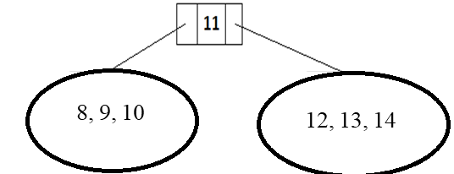
Preorder-Inorder
Preorder: 11, 9, 8, 10, 13, 12, 14
Inorder: 8, 9, 10, 11, 12, 13, 14
Root = 11 (From Preorder)
Left subtree contains 8, 9, 10 (From inorder)
Right subtree contains 12, 13, 14 (From inorder)

Slide 42
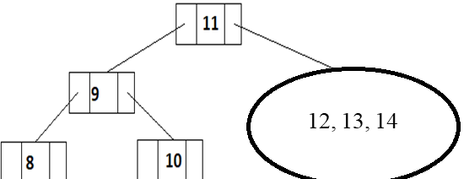
Preorder-Inorder
Preorder: 11, 9, 8, 10, 13, 12, 14
Inorder: 8, 9, 10, 11, 12, 13, 14
Subtree contains 8,9,10
Root node: 9 (From preorder)
Left subtree: 8 (From inorder)
Right subtree: 10 (From inorder)

Slide 43
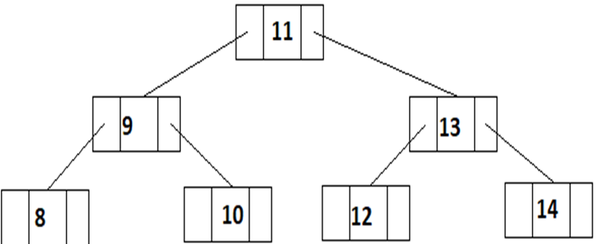
Preorder-Inorder
Preorder: 11, 9, 8, 10, 13, 12, 14
Inorder: 8, 9, 10, 11, 12, 13, 14
Subtree contains 12,13,14
Root node: 13 (From preorder)
Left subtree: 12 (From inorder)
Right subtree: 14 (From inorder)

Slide 44

Postorder-Inorder
Postorder: 8, 10, 9, 12, 14, 13, 11
Inorder: 8, 9, 10, 11, 12, 13, 14
Root = 11 (From Postorder)
Left subtree contains 8, 9, 10 (From inorder)
Right subtree contains 12, 13, 14 (From inorder)

Slide 45
Postorder-Inorder
Postorder: 8, 10, 9, 12, 14, 13, 11
Inorder: 8, 9, 10, 11, 12, 13, 14
Subtree contains 8,9,10
Root node: 9 (From postorder)
Left subtree: 8 (From inorder)
Right subtree: 10 (From inorder)

Slide 46
Postorder-Inorder
Postorder: 8, 10, 9, 12, 14, 13, 11
Inorder: 8, 9, 10, 11, 12, 13, 14
Subtree contains 12,13,14
Root node: 13 (From postorder)
Left subtree: 12 (From inorder)
Right subtree: 14 (From inorder)

Slide 47
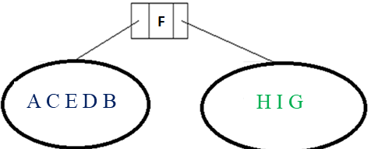
Preorder-Postorder
Preorder: F B A D C E G I H
Postorder: A C E D B H I G F
Root node: F (From preorder)
Left subtree: A, C, E, D, B (From preorder and postorder)
Right subtree: H I G (From preorder and postorder)

Slide 48
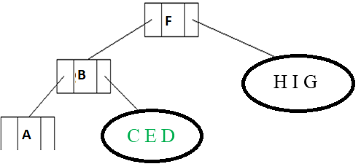
Preorder-Postorder
Preorder: F B A D C E G I H
Postorder: A C E D B H I G F
Root node: B (From preorder)
Left subtree: A (From preorder and postorder)
Right subtree: C E D (From preorder and postorder)

Slide 49
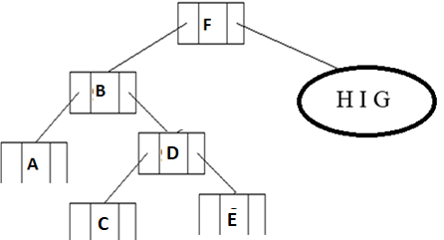
Preorder-Postorder
Preorder: F B A D C E G I H
Postorder: A C E D B H I G F
Root node: D (From preorder)
Left subtree: C (From preorder and postorder)
Right subtree: E (From preorder and postorder)

Slide 50
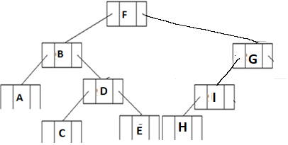
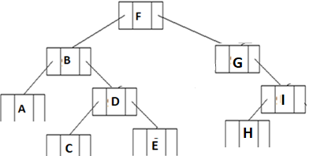
Preorder-Postorder
Preorder: F B A D C E G I H
Postorder: A C E D B H I G F
Not possible to construct unique binary tree when preorder and postorder given.
Root node: G (From preorder)
Left subtree: I H (From preorder and postorder)
or
Right subtree: I H (From preorder and postorder)

Slide 51
Heap tree
Heap is a complete binary tree that satisfies the following properties:
Max heap: For each node N in H, the value at N is greater than or equal to value of each children of N.
Min heap: For each node N in H, the value at N is smaller than or equal to value of each children of N.
Applications:
Heap sort
Implementation of priority queue

Slide 52
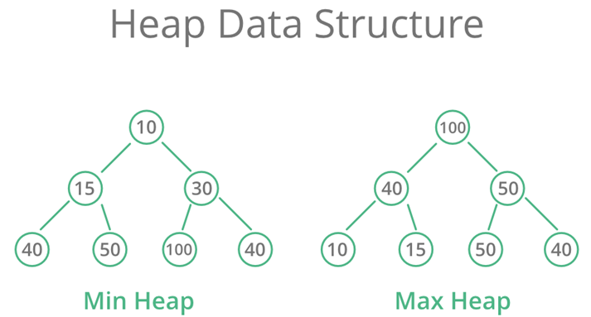
Heap tree

Slide 53
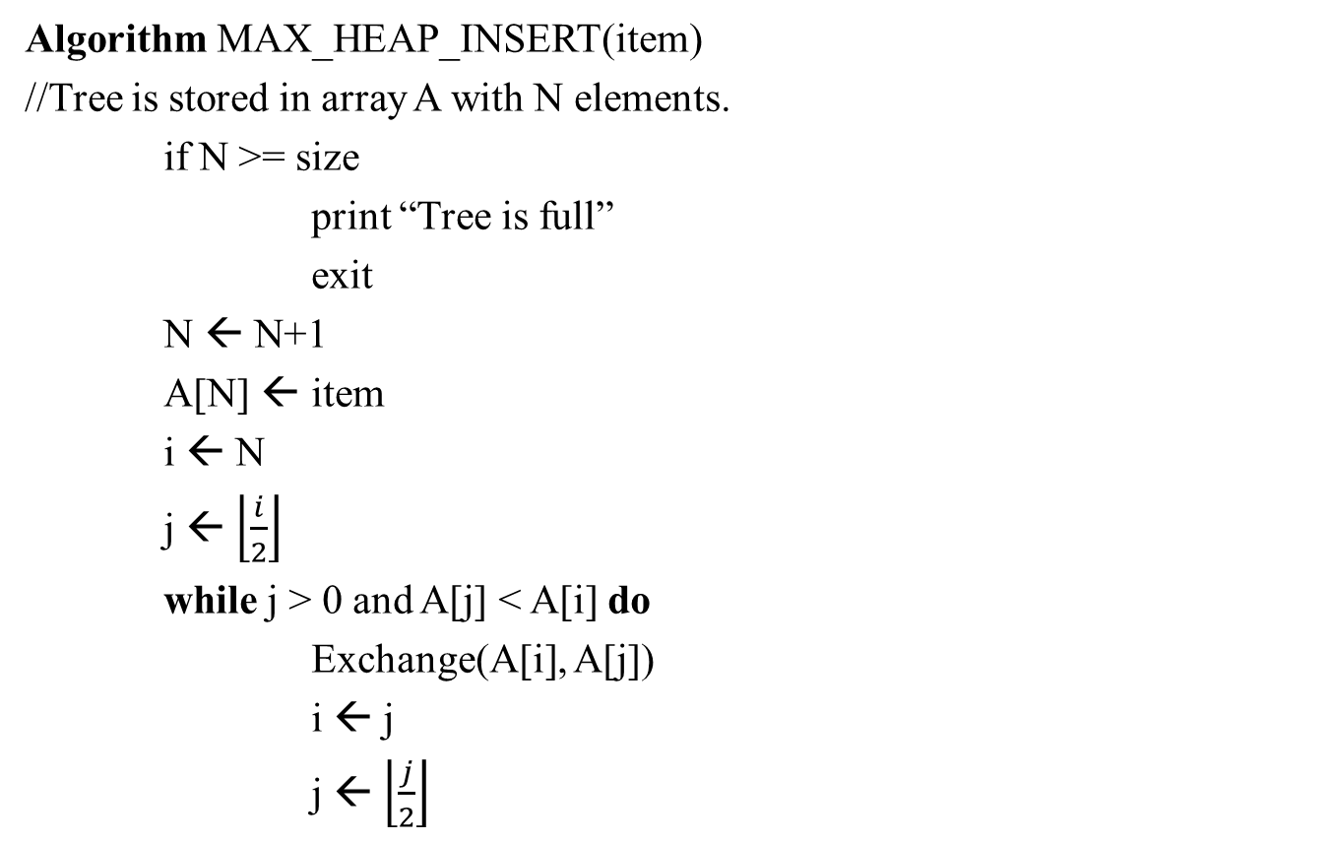
Heap tree (Insert)
Algorithm MAX_HEAP_INSERT(item)
//Tree is stored in array A with N elements.
if N >= size
print “Tree is full”
exit
N ← N+1
A[N] ← item
i ← N
j ← $\left\lfloor \frac{i}{2}\right\rfloor$
while j > 0 and A[j] < A[i] do
Exchange(A[i], A[j])
i ← j
j ← $\left\lfloor \frac{j}{2}\right\rfloor$

Slide 54
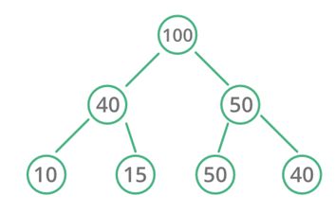
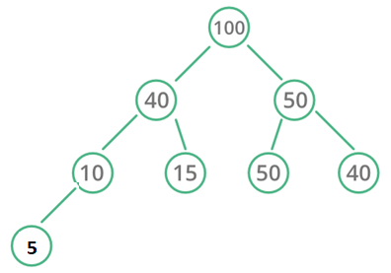
Heap tree (Insert) Example
1 | 2 | 3 | 4 | 5 | 6 | 7 | 8 | 9 | 10
100 | 40 | 50 | 10 | 15 | 50 | 40
Insert(5)
i ← 8
j ← 8/2 = 4
A[j] > A[i] ➔ Return
1 | 2 | 3 | 4 | 5 | 6 | 7 | 8 | 9 | 10
100 | 40 | 50 | 10 | 15 | 50 | 40 | 5

Slide 55
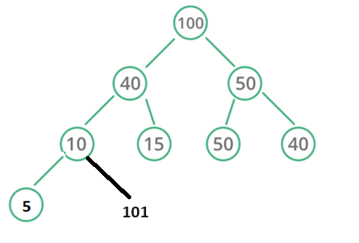
Heap tree (Insert) Example
1 | 2 | 3 | 4 | 5 | 6 | 7 | 8 | 9 | 10
100 | 40 | 50 | 10 | 15 | 50 | 40 | 5
Insert(101)
1 | 2 | 3 | 4 | 5 | 6 | 7 | 8 | 9 | 10
100 | 40 | 50 | 10 | 15 | 50 | 40 | 5 | 101
i ← 9
j ← 9/2 = 4
A[j] < A[i] ➔ Exchange
1 | 2 | 3 | 4 | 5 | 6 | 7 | 8 | 9 | 10
100 | 40 | 50 | 101 | 15 | 50 | 40 | 5 | 10

Slide 56
Heap tree (Insert) Example
1 | 2 | 3 | 4 | 5 | 6 | 7 | 8 | 9 | 10
100 | 40 | 50 | 10 | 15 | 50 | 40 | 5
Insert(101)
1 | 2 | 3 | 4 | 5 | 6 | 7 | 8 | 9 | 10
100 | 40 | 50 | 101 | 15 | 50 | 40 | 5 | 10
i ← 4
j ← 4/2 = 2
A[j] < A[i] ➔ Exchange
1 | 2 | 3 | 4 | 5 | 6 | 7 | 8 | 9 | 10
100 | 101 | 50 | 40 | 15 | 50 | 40 | 5 | 10

Slide 57
Heap tree (Insert) Example
1 | 2 | 3 | 4 | 5 | 6 | 7 | 8 | 9 | 10
100 | 40 | 50 | 10 | 15 | 50 | 40 | 5
Insert(101)
1 | 2 | 3 | 4 | 5 | 6 | 7 | 8 | 9 | 10
100 | 101 | 50 | 40 | 15 | 50 | 40 | 5 | 10
i ← 2
j ← 2/2 = 1
A[j] < A[i] ➔ Exchange
1 | 2 | 3 | 4 | 5 | 6 | 7 | 8 | 9 | 10
101 | 100 | 50 | 40 | 15 | 50 | 40 | 5 | 10

Slide 58
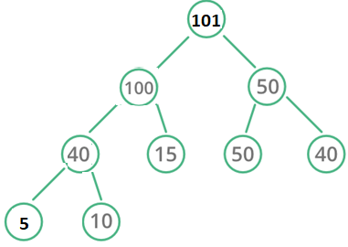
Heap tree (Insert) Example

Slide 59
Heap tree (Delete)
Algorithm MAX_HEAP_DELETE( )
if N = 0 then
print “Empty Tree”
exit
item ← A[1]
A[1] ← A[N]
N ← N – 1
flag ← FALSE
i ← 1
while flag = FALSE and i < N do
left ← 2*i, right ← 2*i +1
if A[i] > A[left] and A[i] > A[right] then
flag ← TRUE
else if A[left] > A[right] and A[i] < A[left] then
Swap(A[i], A[left])
i ← left
else if A[right] > A[left] and A[i] < A[right] then
Swap(A[i], A[right])
i ← right

Slide 60
Heap tree (Delete) Example

Slide 61
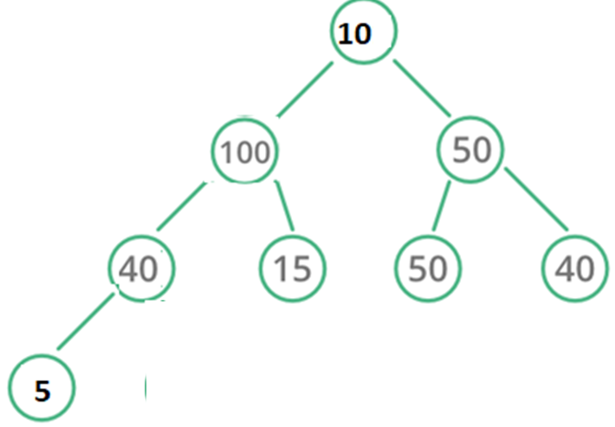
Heap tree (Delete) Example

Slide 62
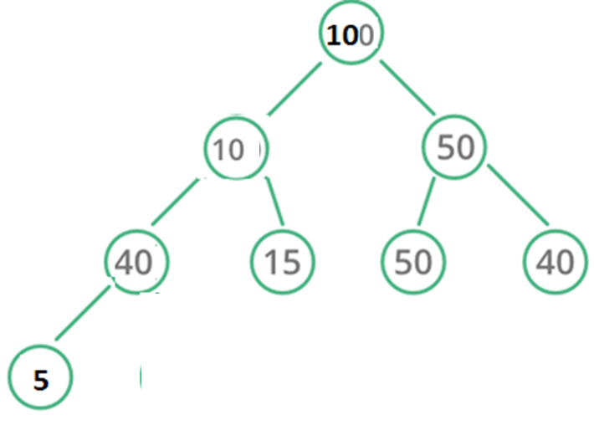
Heap tree (Delete) Example

Slide 63
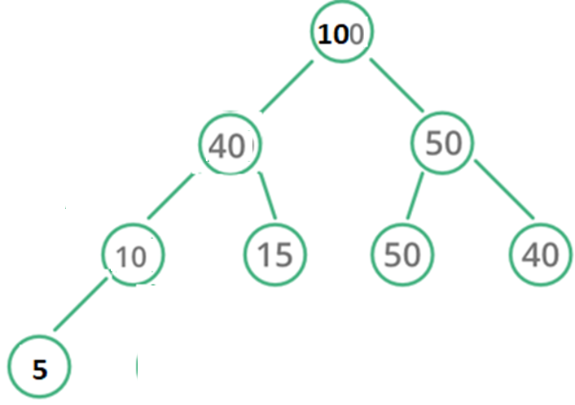
Heap tree (Delete) Example

Slide 64
Heap tree (Delete) Example

Slide 65
Applications: Heap Sort
Step 1: Build a max/min heap tree with the given data.
Step 2: Repeat until tree is not empty
a) Delete the root node from heap and replace last node at root node.
b) Rebuild the heap after deletion.
c) Place the deleted node value in the output.
Step 3: Reverse the output if max heap was used.

Slide 66
Applications: Heap Sort
Algorithm Heap_Sort(data)
Create_Max_Heap(data)
i ← N //N is number of elements in data
while i > 1 do
Swap(data[1], data[i])
i ← i-1
j ← 1
while j < i do
left ← 2*j
right ← 2*j + 1
if data[j] < data[left] and data[left] > data[right] then
Swap(data[j], data[left])
j ← left
else if data[j] < data[right] and data[right] > data[left] then
Swap(data[j], data[left])
j ← right
else
break

Slide 67
Applications: Implementation of Priority Queue
A priority queue is a type of queue that arranges elements based on their priority values.
Properties:
Every item has a priority associated with it.
An element with high priority is dequeued before an element with low priority.
If two elements have the same priority, they are served according to their order in the queue.
P1 | P2 | P3 | P4 | P5 | P6 | P7 | P8 | P9 | P10
5 | 4 | 3 | 4 | 5 | 5 | 3 | 2 | 1 | 5

Slide 68
Applications: Implementation of Priority Queue
Step 1: Build a max heap tree with the given data as per priority value.
Step 2: Repeat until tree is not empty
a) Delete the root node from heap and replace last node at root node.
b) Rebuild the heap after deletion.
c) Place the deleted node value in the output.

Slide 69
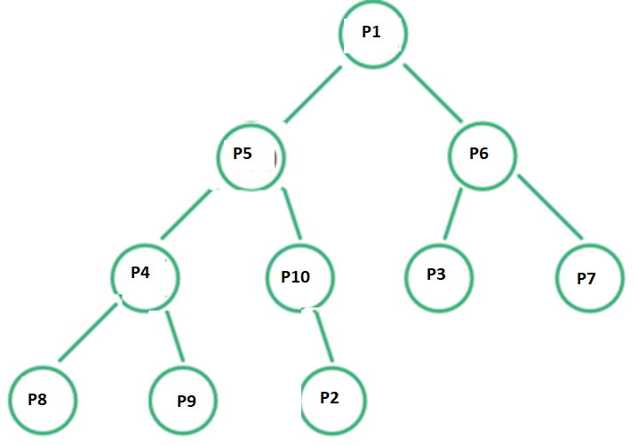
Applications: Implementation of Priority Queue

Slide 70
References
Algorithms Design: Foundations, Analysis and Internet Examples Michael T. Goodrich, Roberto Tamassia, 2006, Wiley (Students Edition)
Data Structures, Algorithms and Applications in C++, Sartaj Sahni, Second Ed, 2005, Universities Press
Introduction to Algorithms, TH Cormen, CE Leiserson, RL Rivest, C Stein, Third Ed, 2009, PHI

Slide 71
Any Question!!

Slide 72
Thank you!!

